Slide 1
StyleGAN
杨彬鑫

Slide 2
GAN
01

Slide 3
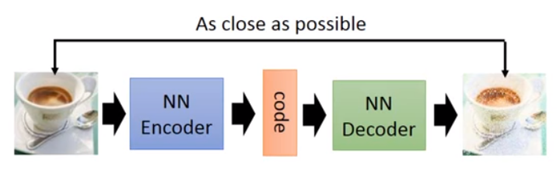
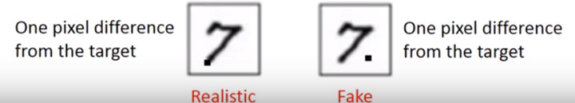
Generation
Hole in latent space
MSE Error

Slide 4
GAN
Full latent space
Better objective function
Noise Vector
Generator/Decoder
Image
Discriminator

Slide 5
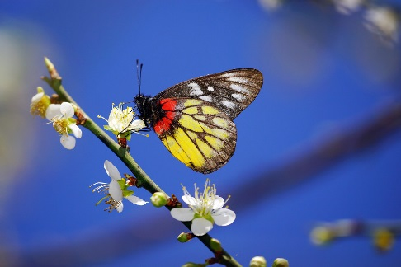
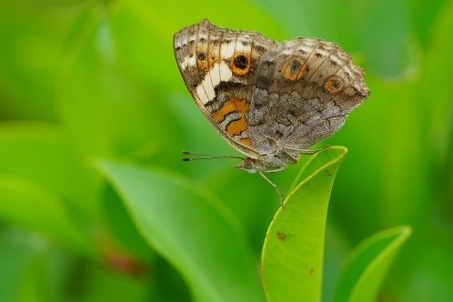
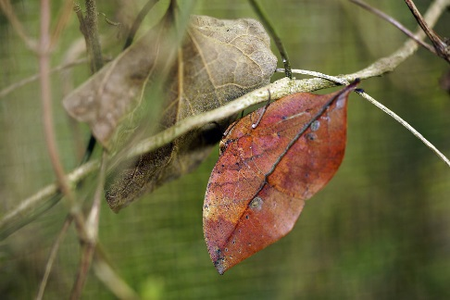
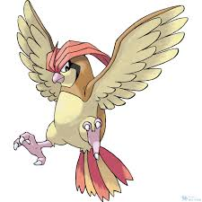
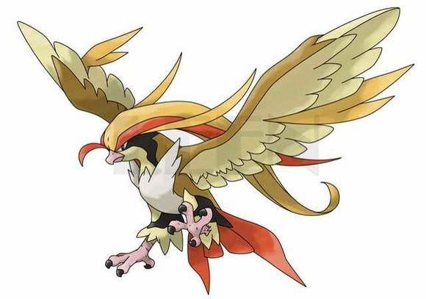
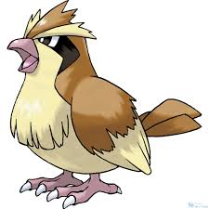
Basic Idea of GAN
Generator
Brown
veins
Butterflies are not brown
Butterflies do not have veins
……..
Discriminator
Notes:
http://peellden.pixnet.net/blog/post/40406899-2013-%E7%AC%AC%E5%9B%9B%E5%AD%A3%EF%BC%8C%E5%86%AC%E8%9D%B6%E5%AF%82%E5%AF%A5
Kallima inachus
Vein
dried leaf

Slide 6
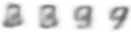

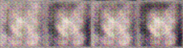
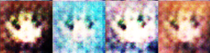
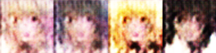




Basic Idea of GAN
This is where the term “adversarial” comes from.
NN
Generator
v1
NN
Generator
v2
NN
Generator
v3
Discri-minator
v1
Discri-minator
v2
Discri-minator
v3
Real images:
Notes:
Binary
Classifier

Slide 7
AdaIN
02

Slide 8
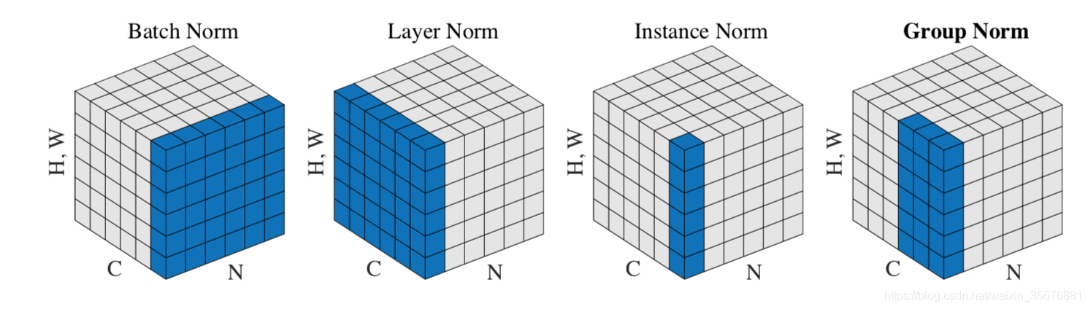
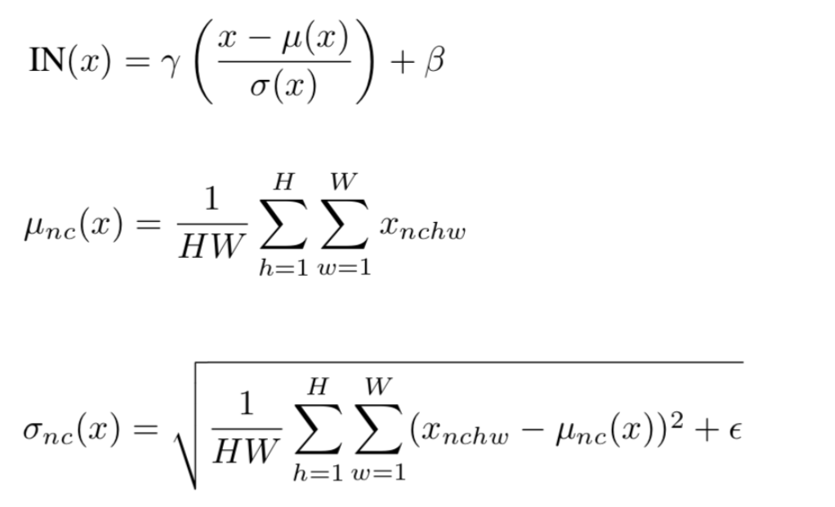
Arbitrary Style Transfer in Real-time with Adaptive Instance Normalization （ICCV 2017）

Slide 9
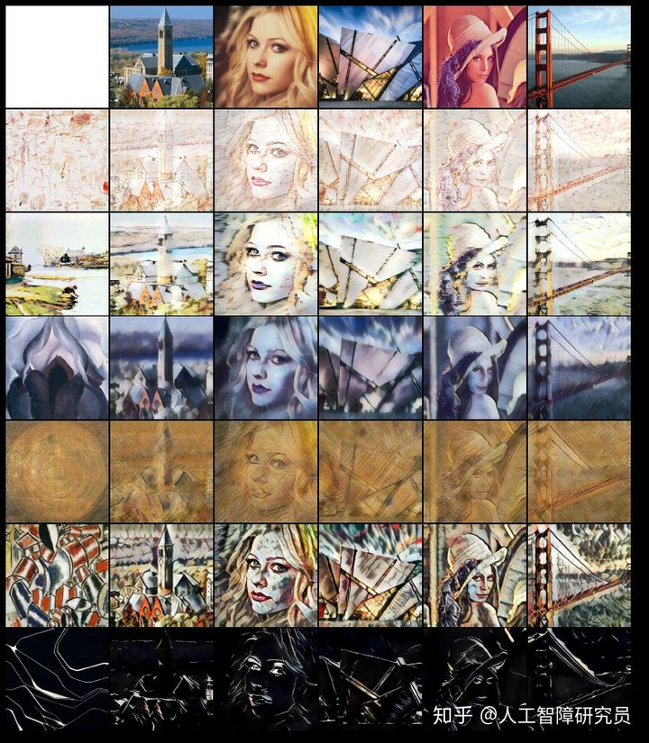
Arbitrary Style Transfer in Real-time with Adaptive Instance Normalization （ICCV 2017）

Slide 10
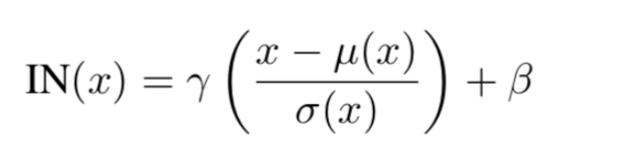
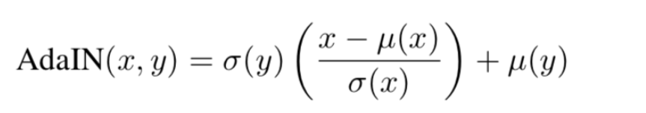
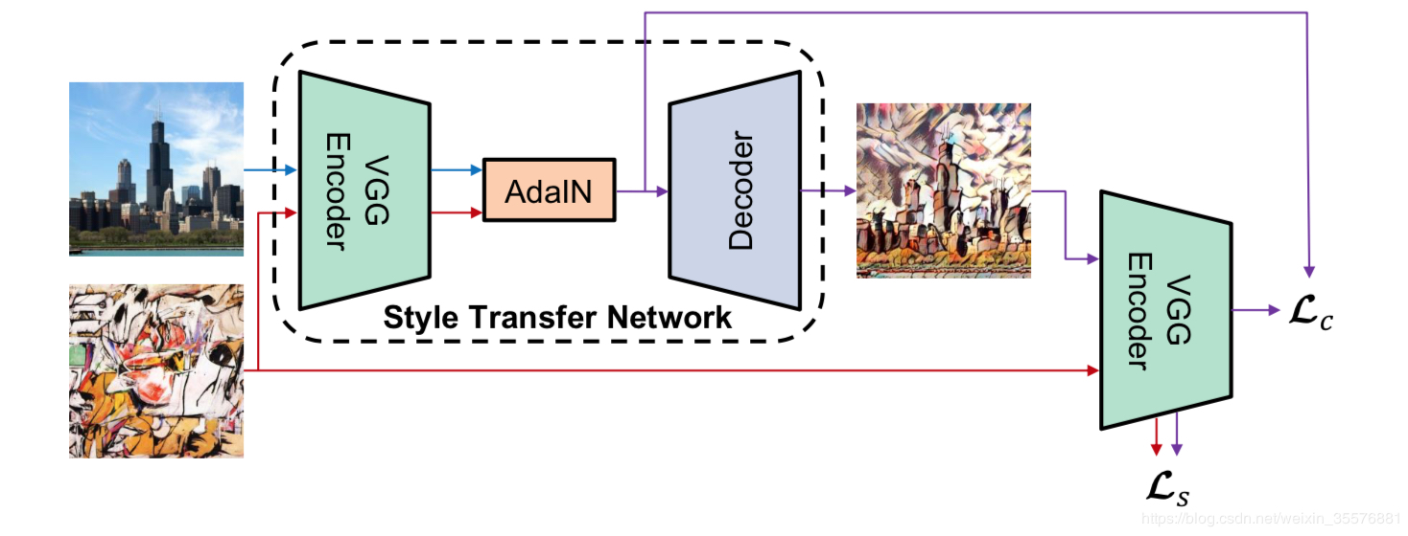
Arbitrary Style Transfer in Real-time with Adaptive Instance Normalization （ICCV 2017）

Slide 11
StyleGAN
03

Slide 12
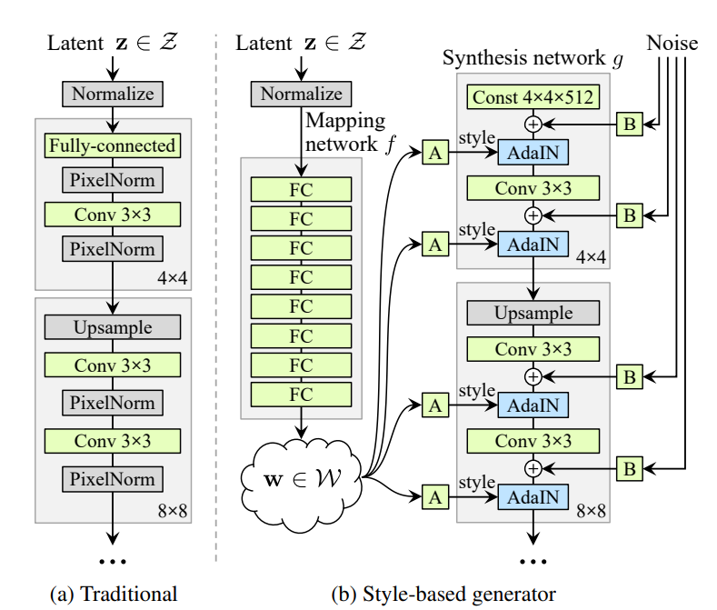
A Style-Based Generator Architecture for Generative Adversarial Networks (CVPR 2019)
Disentanglement
Latent Space
Layers

Slide 13
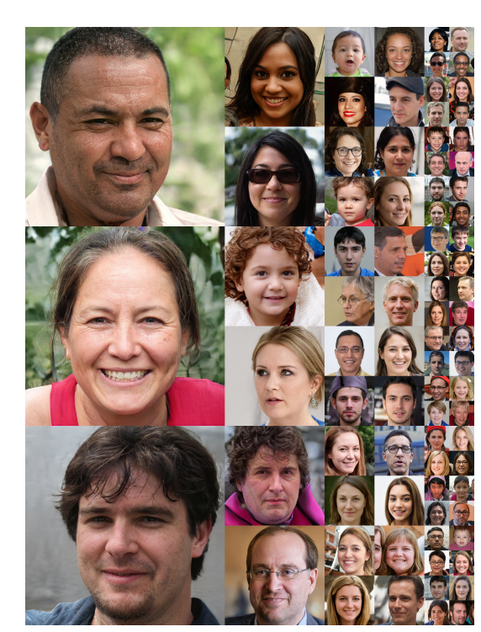
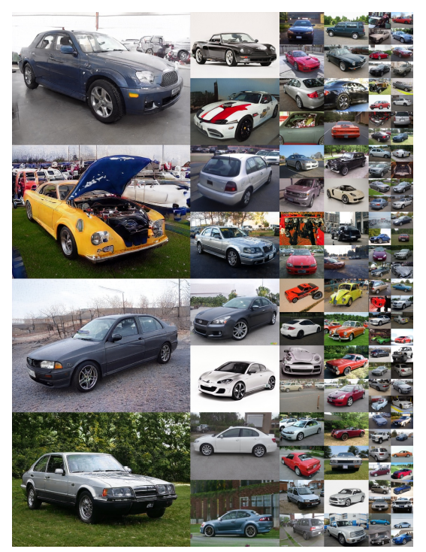
A Style-Based Generator Architecture for Generative Adversarial Networks (CVPR 2019)

Slide 14
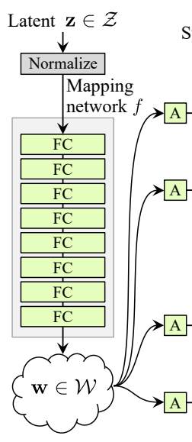
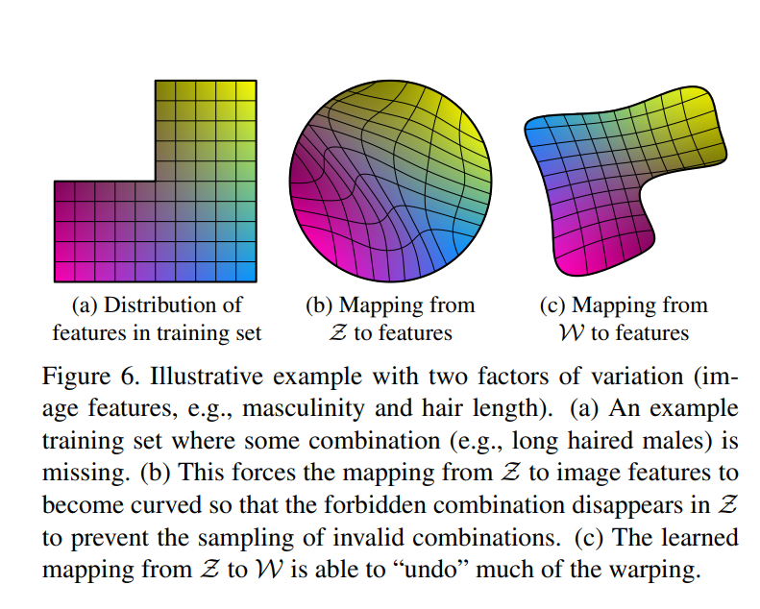
Latent Space Disentanglement

Slide 15
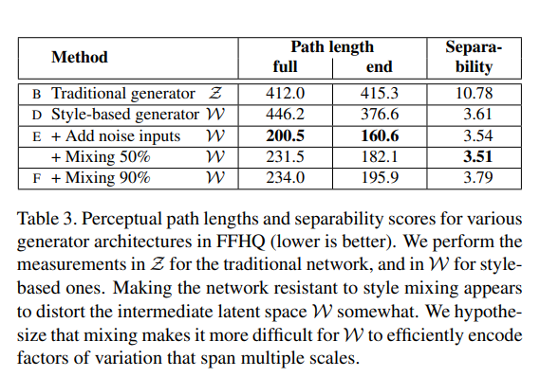
Latent Space Disentanglement

Slide 16
Level Disentanglement

Slide 17
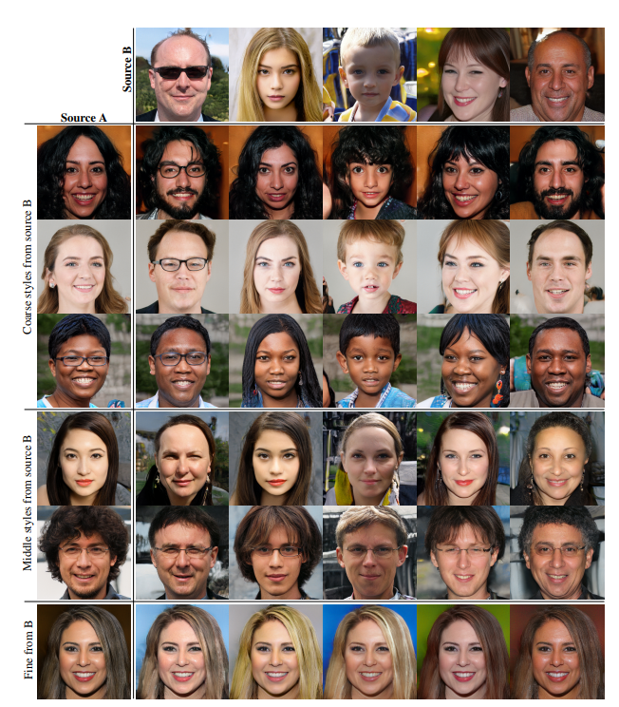
Level Disentanglement

Slide 18
谢谢！
结束页

